Slide 1
Digital Twin for Campus Water Management
1

Slide 2
Project Objective
Develop a Digital Twin System for real-time water consumption monitoring across campus buildings and enhance campus sustainability and water efficiency.
Enable leak detection (Isolation Forest), demand forecasting (Prophet), and valve control simulation (mechanism is attached at the slide 17)
Replace legacy log-based monitoring with a real-time, interactive DT
Improve water usage visibility and support data-driven decisions for campus facilities, examples mentioned in the next slide:
2

Slide 3
support data-driven decisions for campus facilities:
4. High Spikes → Alert for Unauthorized Water Use
Example: Sudden spike in BGMD on a weekend with no occupancy. → Admin cross-checks for unauthorized use, gate leaks, or misuse by outsiders
5. Block Comparison → Infrastructure Investment
Example: Dashboard reveals that Block B consistently uses 40% more water than Block A, despite similar occupancy. → Leads to investigation → discovered old fixtures in Block B. → Decision made to retrofit B block with low-flow taps and flushes.
6. Valve Control Simulation → Smart Water Saving
Example: Digital Twin simulates closing all terrace floor valves at night. → When simulated over 30 days, it shows 15% less average loss, prompting actual valve automation install.
1. Leak Detection → Immediate Maintenance Dispatch
Example: Night-time leakage is detected in Block B1MF and an alert is raised on the dashboard. → Facility Manager sends a plumber directly to the affected room without waiting for complaint calls.
2. Consumption Trends → Tank Refill Scheduling
Example: The dashboard shows that terrace tanks in Block A are being drained faster than others every Friday due to weekend prep. → Operations team schedules refills earlier or adds secondary storage just for Fridays.
3. Forecasting → Preventive Water Tank Cleaning
Example: Demand forecast shows low consumption over an upcoming 4-day holiday break. → Maintenance team plans water tank cleaning or pipe flush operations during that window.
3

Slide 4
System Architecture
Process flow
24 water meters (domestic + flush) → connected to 3 DCUs (Block A, Block B, Terrace)
DCUs push data to a Local Server in every few minutes
Data transferred via SCP/SSH to the dashboard host every 1–2 hours/whenever packet received at local server
Host runs scheduled tasks to clean/merge logs → generate a master CSV
Dashboard uses Streamlit, Pandas, and Pillow (image overlay), Plotly (interactive sensor clicks):
Meter readings on a campus layout
Leak detection using ML/thresholding(IEEE survey?)
Valve toggle interface
Google Sheets integration for cloud logging (alerts, valve events)
4

Slide 5
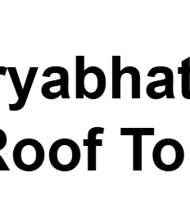
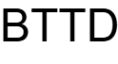
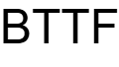

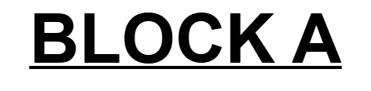
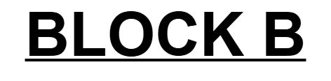
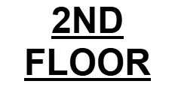
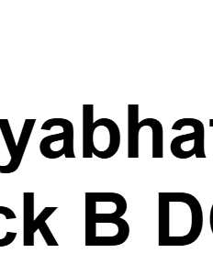
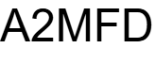
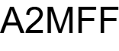
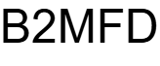
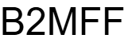
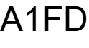
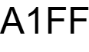
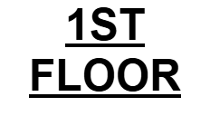
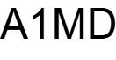
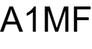
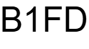
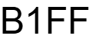
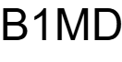
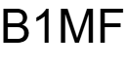
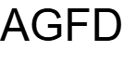
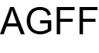
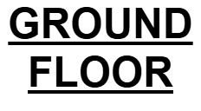
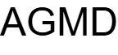
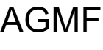
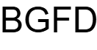
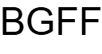
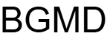
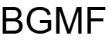
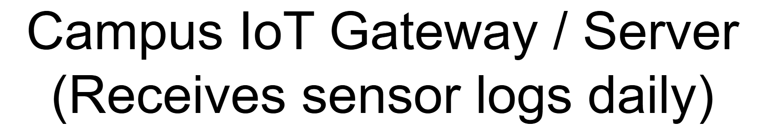

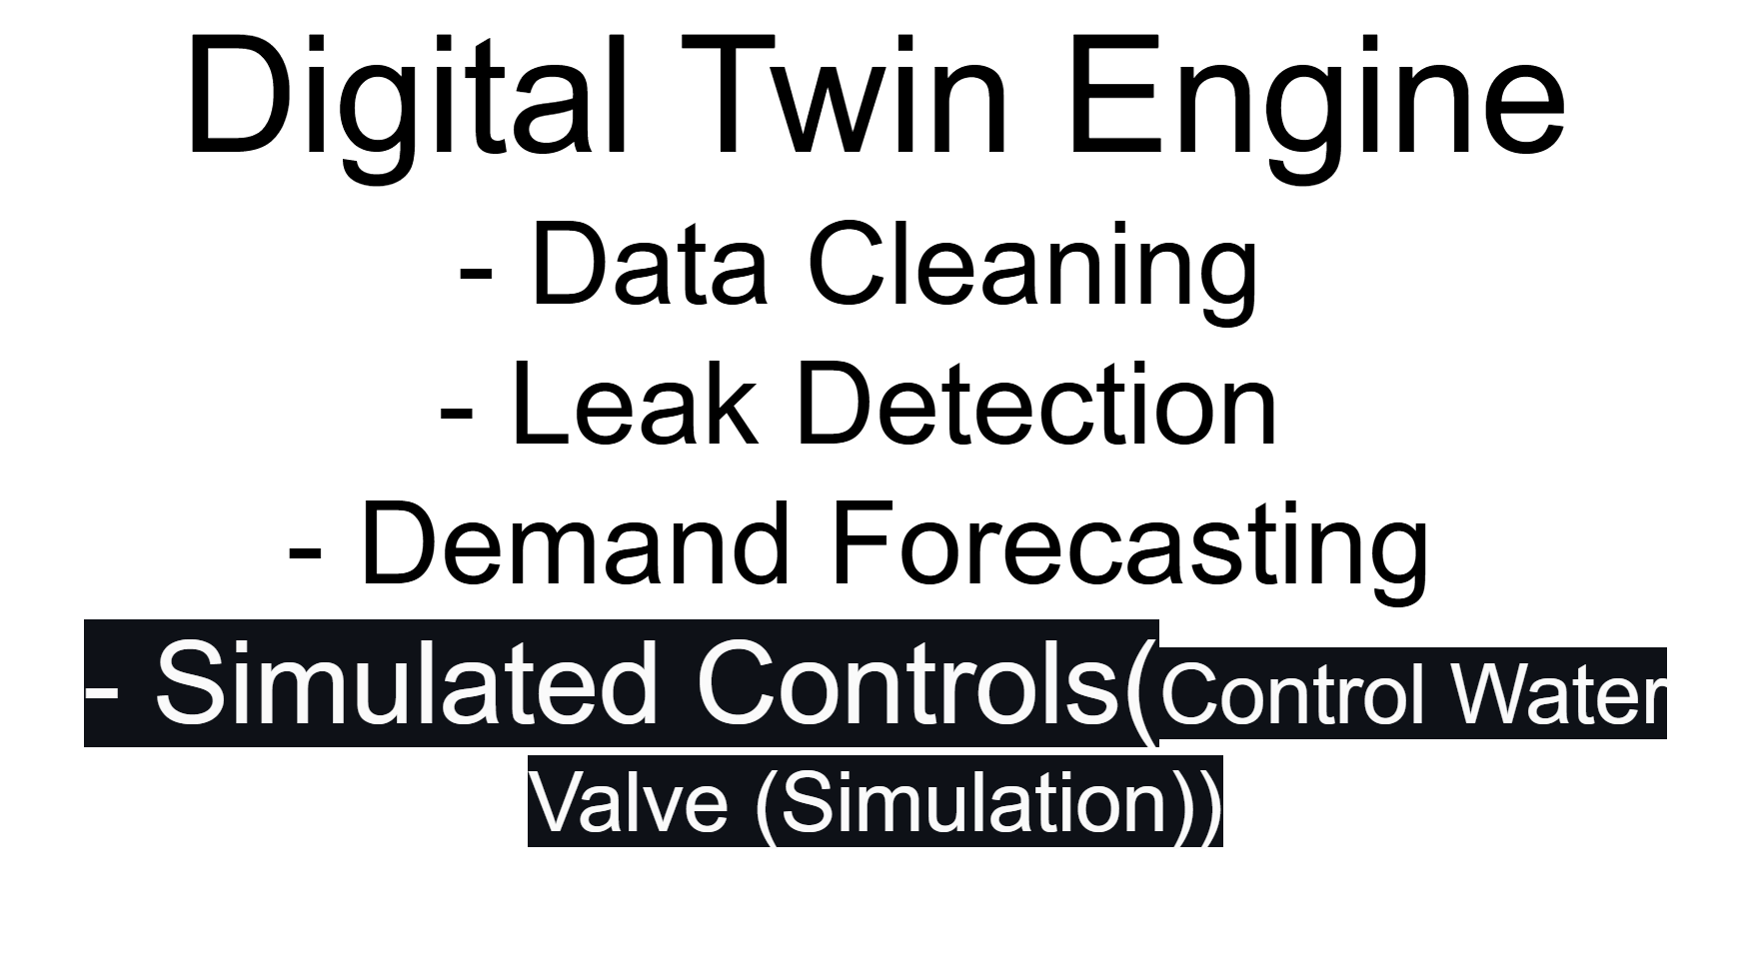
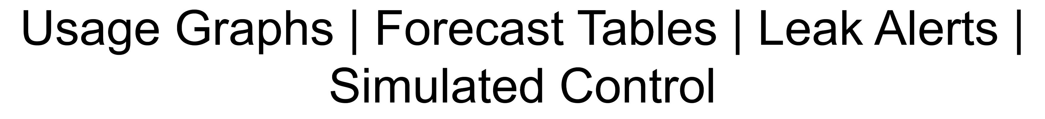
Aryabhatta Block Roof Top DCU3
Aryabhatta Block Roof Top DCU3
Aryabhatta Block A DCU1
Aryabhatta Block B DCU2
5

Slide 6

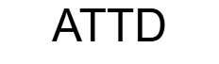
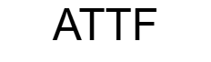
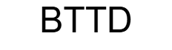
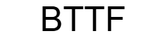

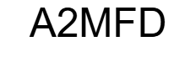
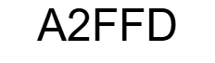
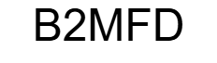
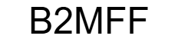
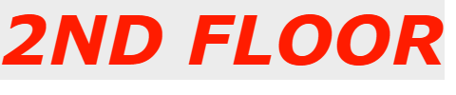
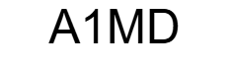
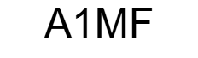
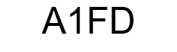
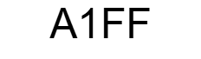
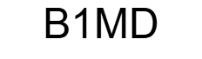
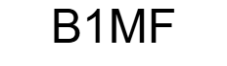
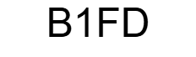
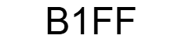
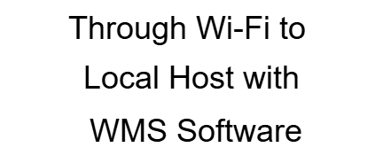














Campus Deployment Plan
Ground Floor
6

Slide 7


















24 water Meters/sensors
3
Create CSV files
4
1
2
Receive packets at local host
5
6
7
9
8
Real Time Dashboard
Process flow Block Diagram of WMS SOFTWARE
7
Deployment Diagram

Slide 8

24-HOUR TIMING DIAGRAM OF THE PROCESS FLOW
9.
8.
7.
6.
5.
4.
3.
2.
1.
8

Slide 9
Implemented Features
Automated data pipeline: from DCUs → server → laptop (via SCP)
import_data.py: merges all CSVs into a clean dataset
spike_alerts.py, night_leak_alerts.py: detect suspicious usage/leaks
demand_forecast.py: predicts 3-day usage trends
Overlay dashboard:
Hourly meter values placed visually on deployment map
Real-Time Digital Twin UI:
Click on sensor → View graph + toggle valve
Updates every hour with new data
Google Sheets Logging:
Logs valve actions and leak alerts in real-time
9

Slide 10
Streamlit Dashboard, Overlay of water readings:
10

Slide 11

11

Slide 12

12

Slide 13

13

Slide 14

14

Slide 15

15

Slide 16
Next Steps
1. Fully automate file sync from local server to dashboard device.
2. Upgrade to fully interactive and visual dashboard.
3. Develop a 3D interactive model (Three.js or Babylon.js) with real-time overlays.
4. Add anomaly detection using time-series ML models (e.g. Prophet, LSTM). 5. Provide admin features: valve override, manual logs, export reports.
6. Create a mobile-friendly UI for quick leak alerts and consumption glance.
7. Integrate edge-based event triggering for critical conditions.
16

Slide 17


Mechanism for future valve control
Command recieved through HTTP API Server on Pi Pico W (works when connected to same wifi) Use MQTT for scalable communication.
17

Slide 18
attack detection, leakage and clog simulation Test data simulator , anamoly simulator to test out alerts steps: specs,design,code,test”:
18

Slide 19
Attack Detection Specifications in Digital Twin-based Water Management System:
⚠️
Water meters and their data pipelines can be targeted through several attack types:
Spoofing – Injecting fake consumption values to mask leaks or trigger false alarms.
Replay Attacks – Re-sending old data to hide real-time changes.
DoS – Overloading the server with excessive packet data to cause failure.
Tampering with valve controls – Unauthorized commands to open/close valves, potentially causing damage.
DT system offers powerful mechanisms for attack detection and impact analysis:
Anomaly-Based Detection – Real-time values are compared with learned patterns to flag deviations.
Redundancy Cross-Validation – DT checks adjacent sensors for inconsistent behavior.
Simulation Injection – Simulate spoofed or delayed packets to test alert mechanisms.
Signature Matching – Identify repeated or recognizable malicious behavior (e.g., midnight packet flood).
Recommended Simulated Attacks for Testing
Attack Type | Simulation Logic
Spoofing | Inject abnormal readings (e.g., 9999.9 L) for 2 hours.
Replay | Copy historical data and resend at a later time.
DoS | Send 1000 identical packets in a short interval.
Packet Loss | Drop packets from selected sensors for 2+ hours.
Goals:
Simulate data tampering, spoofing, or sudden changes.
Detect inconsistent patterns with real sensor behavior.
Raise alerts on possible attack vectors.
19

Slide 20
Leakage, Clog, and Anomaly Simulation for Digital Twin Water Management:
Leakage Simulation specifications: Leakage simulation is used to mimic real-world pipe leaks in the digital model to test detection logic.
Types of leaks to simulate:
• Constant Leak: Low, steady flow during inactivity (e.g., 0.1–0.2L/hr at night).
• Night-time Leak: Triggered only during 12 AM to 5 AM.
• Increasing Leak: Gradually rising leak rate over several hours.
Detection methods include threshold violation, continuous flow beyond active hours, and deviation from expected hourly profiles.
Clog Simulation specifications: Clog simulation reproduces partial or full blockages in pipes.
Types of clog patterns:
• Sudden Drop: From high flow to near zero.
• Partial Drop: 30–70% decrease in consumption.
• Intermittent Clog: On/off flow disruption during typical usage hours.
Digital twin can detect clogs by comparing expected vs actual flow and using machine learning classification of under-consumption behavior.
Goals: Insert gradual or constant small increase in flow/usage.
Trigger the leak alert logic if sustained beyond thresholds.
Goals:
Reduce expected flow sharply or gradually.
Trigger anomaly if no water usage is reported despite open valve.
20

Slide 21
Test Data Simulator
The simulator is responsible for producing synthetic water meter readings in standard packet format (CSV/JSON) including both normal and abnormal cases.
Features:
• Control over building ID, timestamp, and anomaly type.
• Adjustable frequency and duration of anomalies.
• Batch file generation for automated test runs.
Anomaly Simulator
Injects random or rule-based data inconsistencies into the dataset for robustness testing.
Types of anomalies:
• Sensor Freeze – Repeating same value for hours.
• Random Spikes – Sudden, isolated consumption jumps.
• Drift – Gradual increase/decrease over time.
• Missing Data – Gaps in timestamps or consumption.
All anomalies are labeled for evaluation against detection logic in the dashboard.
Goals:
Provide clean, controlled packet data with timestamp and sensor ID.
Mix normal and abnormal entries for testing.
Output:
Synthetic CSV similar to packet logs: sensor_data, timestamp, etc.
Mark data rows with anomaly/attack type for evaluation.
Goals: Modify consumption values or timestamps to mimic:
1.Drift
2.Sensor freeze
3.Random spikes
Output: Annotated CSV for each anomaly case.
Compatibility with alert systems in dashboard.
21

Slide 22
References:
MDPI paper: Zhao et al., 2024, “Digital Twin Smart Water Conservancy:
https://www.mdpi.com/2073-4441/16/14/2038
A Survey on Digital Twin for IIoT, IEEE Access, 2023.: https://ieeexplore.ieee.org/document/10188847/
Survey on Digital Twins: Architecture, Enabling Technologies, Security and Privacy,FutureProspects:https://www.researchgate.net/publication/367977295_A_Survey_on_Digital_Twins_Architecture_Enabling_Technologies_Security_and_Privacy_and_Future_Prospects
water management: 1.https://www.waterlyst.com/articles/digital-twins-water-management
https://blog.dhigroup.com/digital-twins-in-the-water-sector-what-are-they-and-how-do-we-get-there/
Open Source Digital Twin Projects – FIWARE: https://www.fiware.org/
Open Source Digital Twin Projects – Eclipse Ditto: https://www.eclipse.org/
Wang et al., IEEE Access, 2023:
Taylor & Letham, Forecasting at Scale, Meta (Facebook), 2017: https://facebook.github.io/prophet/
Liu et al., Isolation Forest: https://doi.org/10.1109/ICDM.2008.17
Streamlit Official Docs: https://docs.streamlit.io
Google Sheets API: https://developers.google.com/sheets/api
Draw.io / Diagrams.net – Block & Flow Diagram Design: https://app.diagrams.net/
A Framework for Leak Detection in Water Distribution Systems: https://www.sciencedirect.com/science/article/pii/S2468013317300368
Machine Learning Techniques for Predictive Maintenance of Water Infrastructure: https://www.mdpi.com/2076-3417/10/13/4512
Attack Detection in IoT-Enabled Smart Water Grids Using Machine Learning: https://www.sciencedirect.com/science/article/pii/S1389128622002624
Anomaly Detection for Water Distribution Systems Using Autoencoders: https://www.mdpi.com/2071-1050/13/2/567
Cyber-Physical Threats to Water Distribution Networks: https://ieeexplore.ieee.org/document/8644070
Using Google Sheets as a Cloud Logging Tool with Python (gspread): https://docs.gspread.org/en/latest/user-guide.html
Streaming Real-Time Data Using Streamlit and Plotly: https://docs.streamlit.io/

